Slide 1
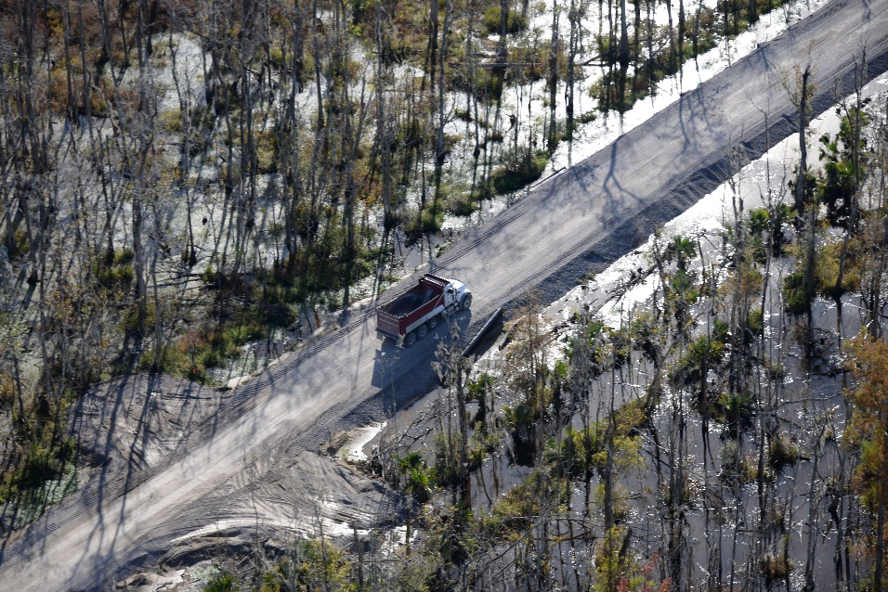
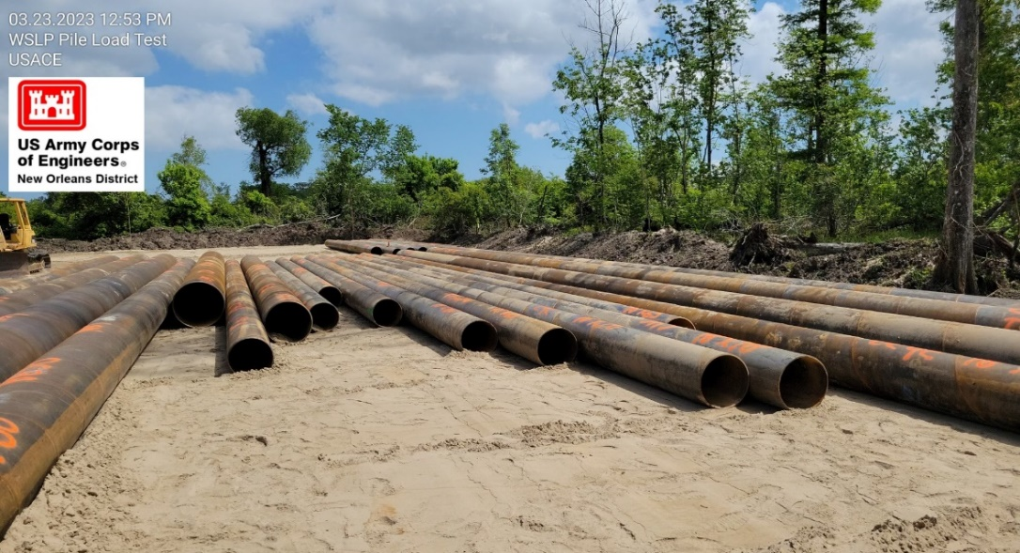
West Shore Lake Pontchartrain Stakeholder Update
May 2023 Patrick Baudoin, P.G. Project Manager New Orleans District U.S. Army Corps of Engineers

Slide 2
Agenda
Disaster Relief Supplemental Appropriations Act, 2022 funding
Design Status
Construction Status/Schedule
https://www.mvn.usace.army.mil/About/Projects/West-Shore-Lake-Pontchartrain/

Slide 3
Disaster Supplemental Funds
$3M provided for a WSLP Reevaluation Report (GRR) focused on resiliency
Considering opportunities for resiliency for entire project
Feasibility Cost Share Agreement (FCSA) executed 27 Feb 23
Pending completion of a report that finds a recommended plan that is economically justified and environmentally acceptable up to $450M in additional construction funds have been set aside for use
Potential to look at additional alternatives in St. James Parish that are economically justified
WSLP Resiliency Charrette occurred 26 April 23

Slide 4
Tentative Resiliency Study Schedule

Slide 5
Pre-Award Status Updates
WSLP-106 I-10 Westernmost Crossing was advertised on 16 May 23
WSLP-102 I-10 Easternmost Crossing P&S advertisement scheduled in mid-June
WSLP-108 Levee and Mississippi Bayou Drainage Structures advertisement scheduled in mid-July
Port of South Louisiana Airport Runway Extension Additional Work Approval Package has been completed, and USACE has received initial funding from CPRA/PLD/Port of South Louisiana and initiated design and environmental compliance efforts
USACE has completed surveys and borings in St. James Parish and is conducting geotechnical analysis/design
Environmental Assessment expected to be released for public review on 2 June for a 30-day review.
Meeting between Colonel Jones and President Hotard on drainage modelling occurred 12 April 23; follow on meeting planned early/mid-June.

Slide 6
Construction Status
WSLP-110 contract was awarded on 21 Dec 22
Clearing and grubbing/burning still underway
WSLP-107 contract was awarded on 15 Mar 23
Culvert pipe to be delivered this week; to start clearing and grubbing soon
WSLP-101a contract was awarded on 28 April 23
Anticipated Preconstruction Meeting – 31 May 23
Anticipated Mobilization – 26 June 23
Stockpile Contracts
Clay 1 – 350k/1000k cubic yards (Averaging 2000 cy/day)
Clay 2 – 500k/500k cubic yards – Completed
Sand – 600k/600k cubic yards – Completed
Pile Load Test Contract
Prescott Site: All test piles have been driven
I-55 Site: Pile driving underway
Reserve Relief Site: Piles have been delivered and are being spliced.

Slide 7
Construction Status: Completed
WSLP-101 Test Section Contract – Completed June 2022
Sand Placement 1 and 2 – Completed in December 22/January 2023
Access Road Contract – Substantially Completed early March 2023

Slide 8
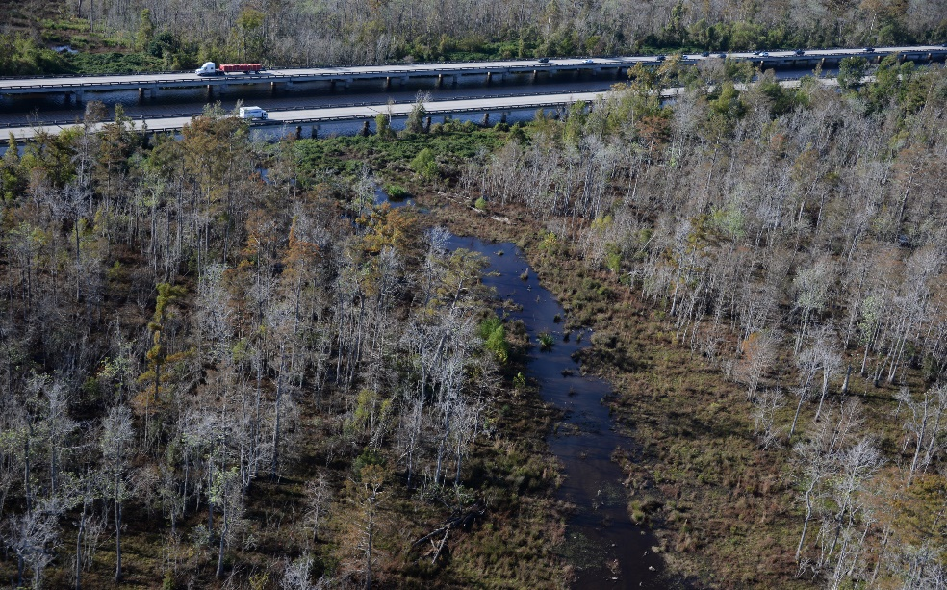
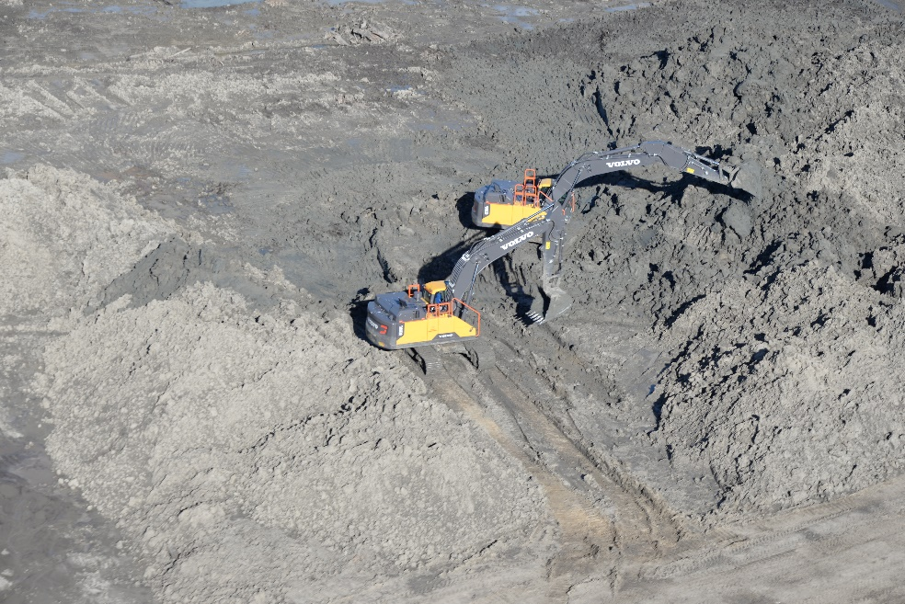
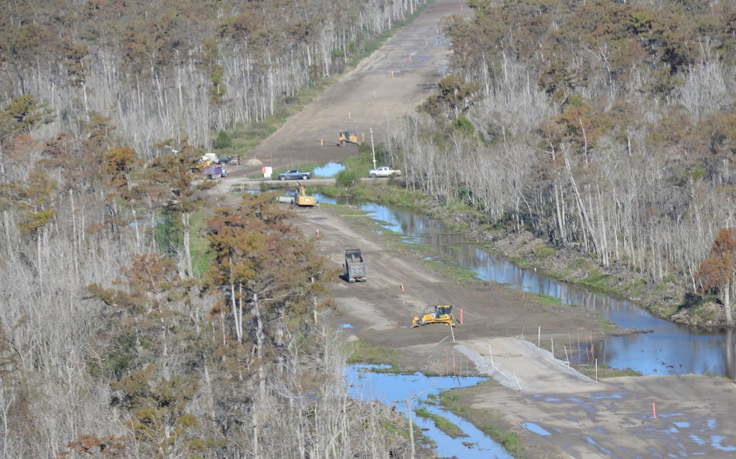
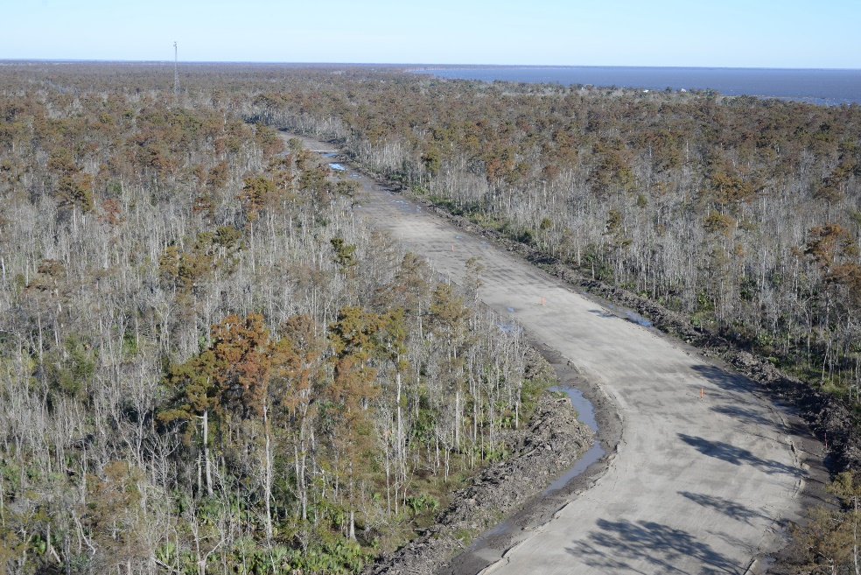
Construction Photos
Previously cleared levee alignment
Clay Stockpile 1 on access Road J
SP2 Sand base placed along levee alignment
SP2 Sand base placed along levee alignment

Slide 9
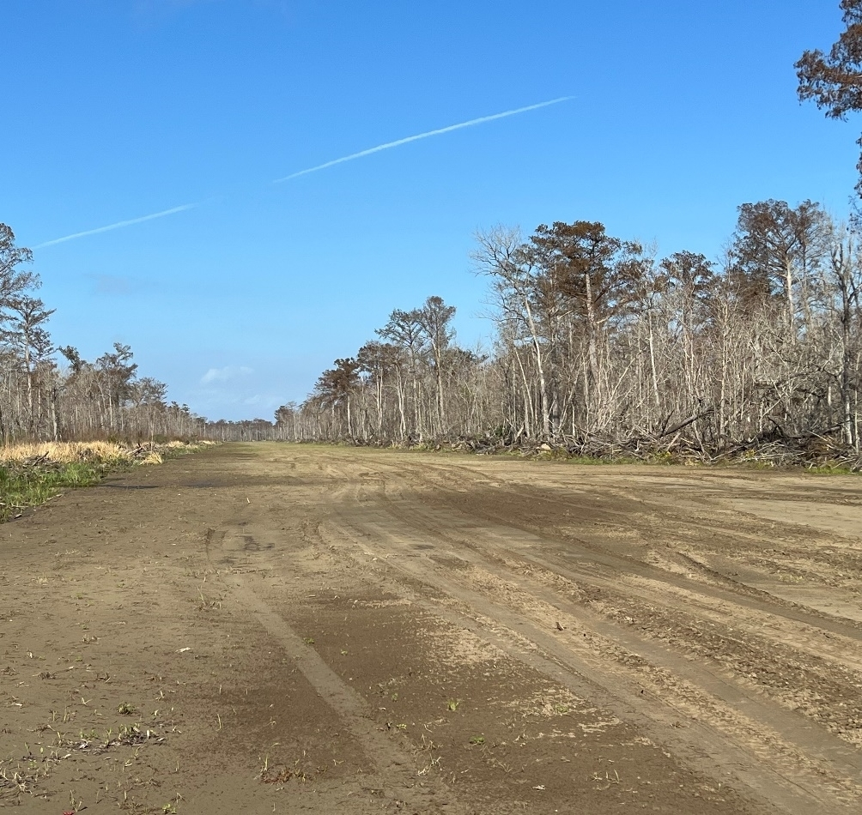
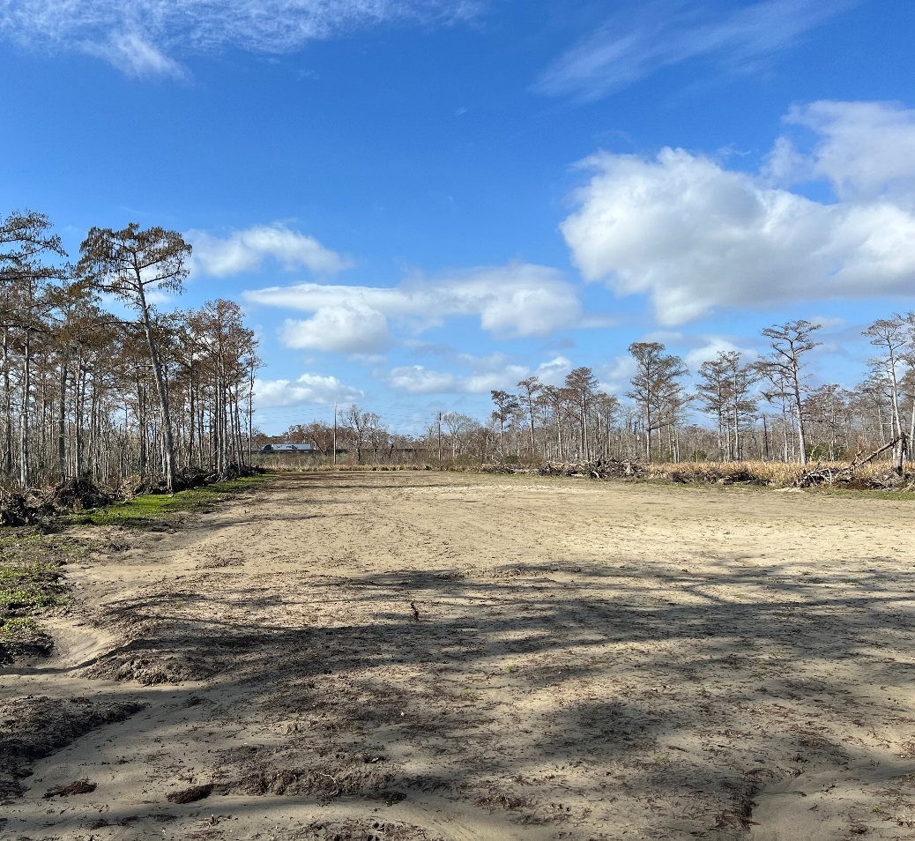
Construction Photos
SP1 at extent of placement
SP2 at extent of placement

Slide 10
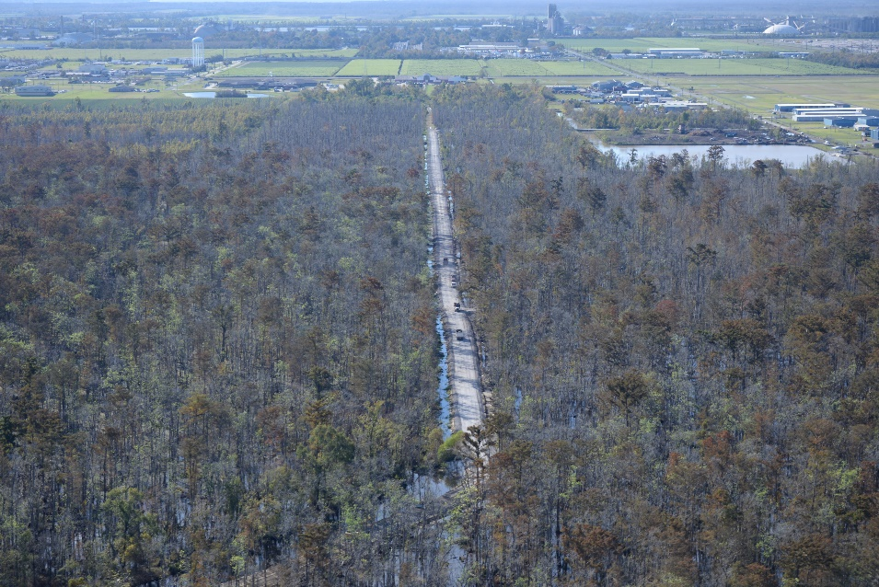
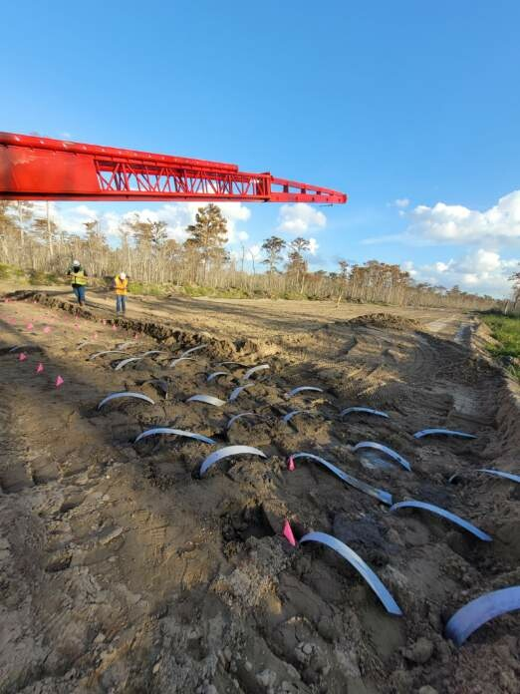
Construction Photos
Land bridge/Access Road D
6 Dec 2022 Sand Placement 2: Wick Drain Installation

Slide 11
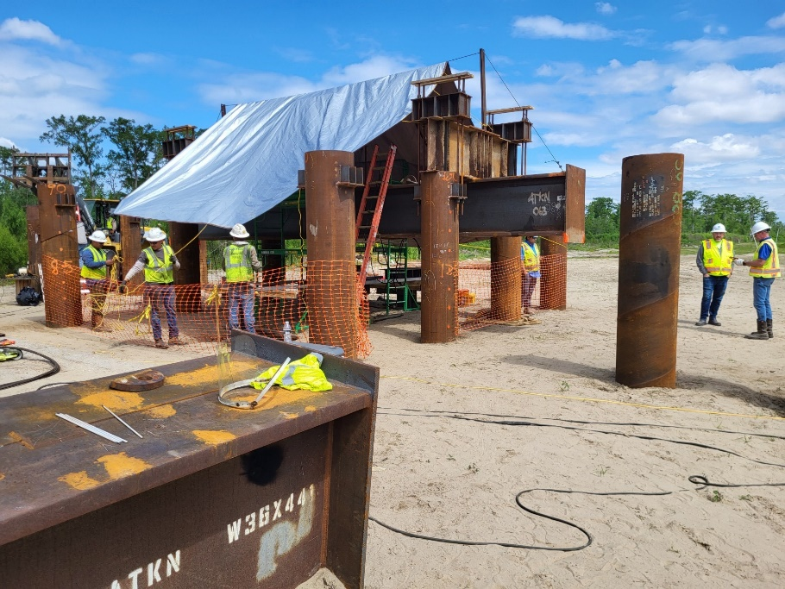
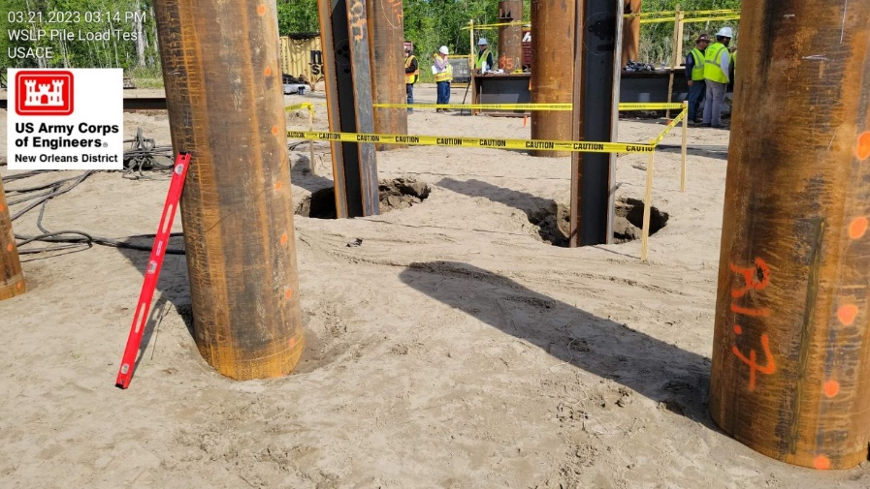
Construction Photos
Pile load testing location –
Prescott (Access Road J)

Slide 12
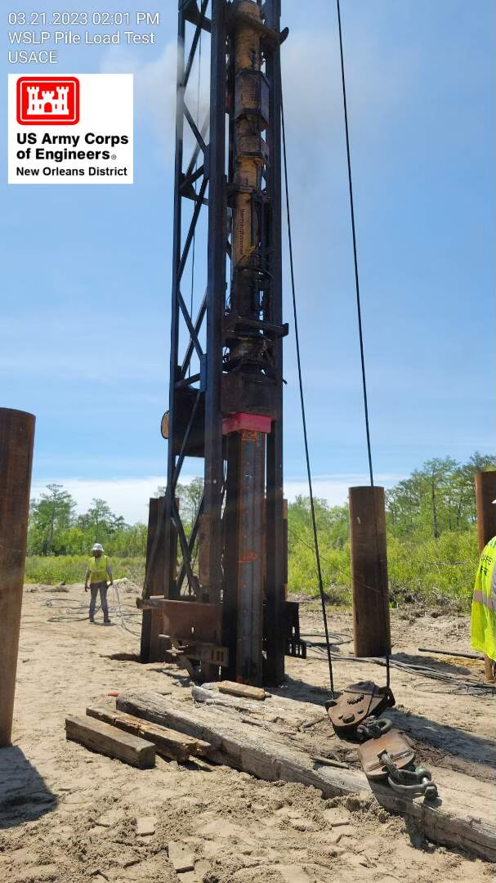
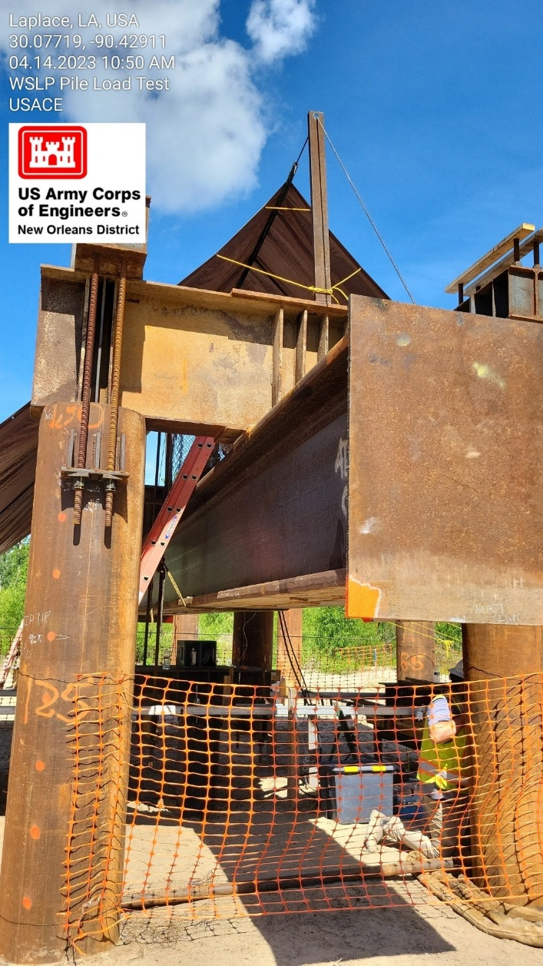
Construction Photos
Prescott
(Access Road J)
Prescott
(Access Road J)

Slide 13
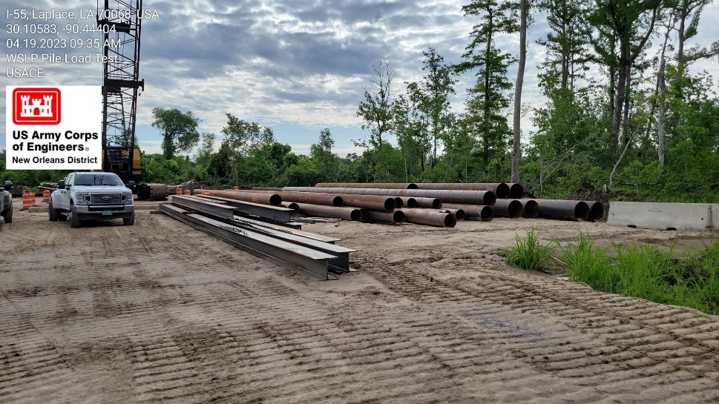
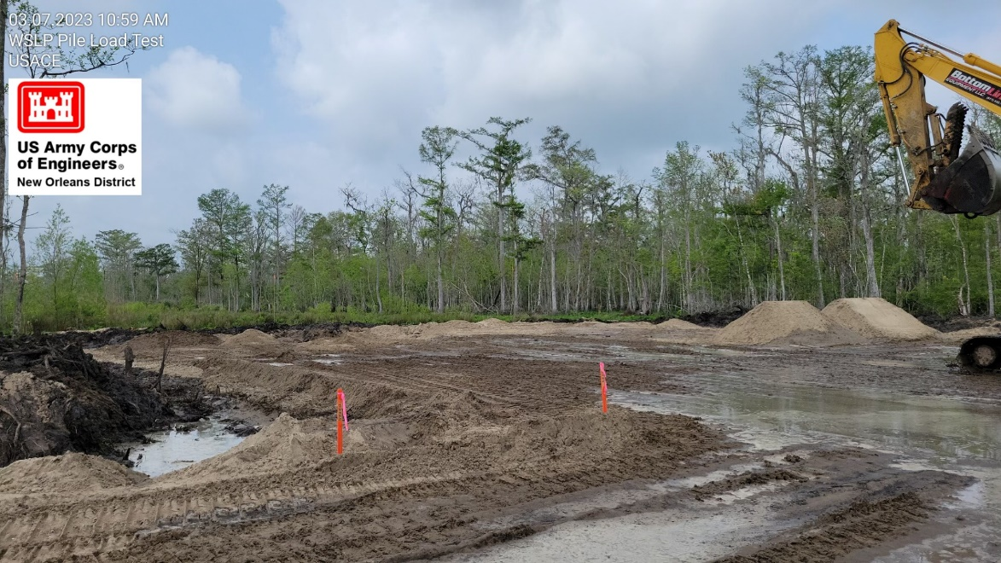
Construction Photos
I-55 (Access road P)
I-55 (Access road P)
Reserve Relief test pad

Slide 14
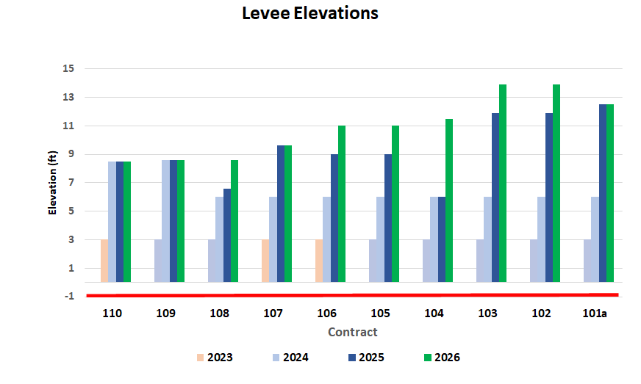
Preliminary Levee Construction Schedule
Existing elevation approx. -1 feet
2023 and 2024: Construct 3-foot sand base and begin levee construction
2024: Levee built to heights around +6 feet
2025: Levee built to heights ranging +6.6 to +12.5 feet
2026: Levee built to full heights
*Gaps will still exist by flood gates, flood walls, drainage structures, and pump stations through 2026
Current Elevation
-1 ft
Hope Canal
Bonnet Carre

Slide 15
West Shore Lake Pontchartrain Tentative Delivery Plan
Contract ID | Description | Award
WSLP 102 | Levee (approx. 1.0 mi.), Floodwall (approx. 500 ft), Drainage Structure | 3Q 2023
WSLP 103 | Levee (approx. 1.0 mi.), Floodwall (approx. 500 ft) | 4Q 2023
WSLP 104 | Levee (approx. 2.5 mi.), Floodwall (approx. 500 ft), Utility Crossings | 3Q 2023
WSLP 105 | Levee (approx. 3.0 mi.), Floodwall (approx. 500 ft), Drainage Structure | 4Q 2023
WSLP 106 | Levee (approx. 0.75 mi.), Floodwall (approx. 500 ft), | 3Q 2023
WSLP 108 | Levee (approx. 1.3 mi.), Floodwall (approx. 500 ft), Drainage structure(s) | 3Q 2023
Note: Project requirements and completion dates may be subject to change as designs are refined and impacts quantified.
Award dates highlighted in green have been actualized.
***Designed and constructed by CPRA

Slide 16
West Shore Lake Pontchartrain Tentative Delivery Plan
Contract ID | Description | Award
WSLP 109 | Levee (approx. 1.0 mi), (approx. 500 ft), Utility Crossings | 4Q 2023
WSLP 111** | Levee (approx. 0.5 mi), Highway Ramp, Utility Crossings | 3Q 2023
WSLP 112** | Levee (approx. 1.0 mi), Rail Road Gate, Floodwall (approx. 500 ft), Utility Crossings | 3Q 2023
WSLP 113** | Levee (approx. 0.5 mi), Floodwall (approx. 500 ft), Rail Road Gate | 3Q 2023
WSLP 114 | Pump Stations (2 – 2,000 cfs) | 4Q 2023
WSLP 114a | Hope and Prescott Drainage Structures | 2Q 2023
Note: Project requirements and completion dates may be subject to change as designs are refined and impacts quantified.
Award dates highlighted in green have been actualized.
***Designed and constructed by CPRA

Slide 19
Questions
Patrick.Baudoin@usace.army.mil

