Slide 1
West Shore Lake Pontchartrain Stakeholder Update August 31, 2022 Bradley Drouant, P.E. Sr. Project Manager New Orleans District U.S. Army Corps of Engineers

Slide 2
Agenda
Disaster Relief Supplemental Appropriations Act, 2022 funding
Design Status
Construction Status/Schedule
https://www.mvn.usace.army.mil/About/Projects/West-Shore-Lake-Pontchartrain/

Slide 3
Disaster Supplemental Funds
$3M provided for a WSLP Reevaluation Report (GRR) focused on resiliency
Will consider opportunities for resiliency for the entire project
Execute Feasibility Cost Share Agreement (FCSA) with CPRA 4QCY 2022
Pending completion of a report that finds a recommended plan that is economically justified and environmentally acceptable up to $450M in additional construction funds have been set aside for use
Potential to look at additional alternatives in St. James Parish that are economically justified

Slide 4
Design Status
Remaining reaches require completion of their respective access roads prior to levee construction.
The team’s goal is to have designs completed so that levee contracts can be awarded as roads are available for use. Levee construction expected to begin in second half of 2022.
Pile Load Test contract was advertised 16 Aug 22, proposals are currently due 14 Sep 22.
USACE has received right-of-entry to begin surveys and borings in St. James Parish 13 Jan 22. A USACE crew has taken CPT tests, and borings are underway. Error was found in survey data and sent back to contractor for resolution. Borings delayed by weather and now expected end of September 2022.
WSLP-109, and WSLP-110 95% Plans and Specifications reviews are ongoing. One of these contracts is likely to be the first levee reach awarded.
Port of South Louisiana Airport runway extension Additional Work Approval Package scheduled to be sent to MVD this week.

Slide 5
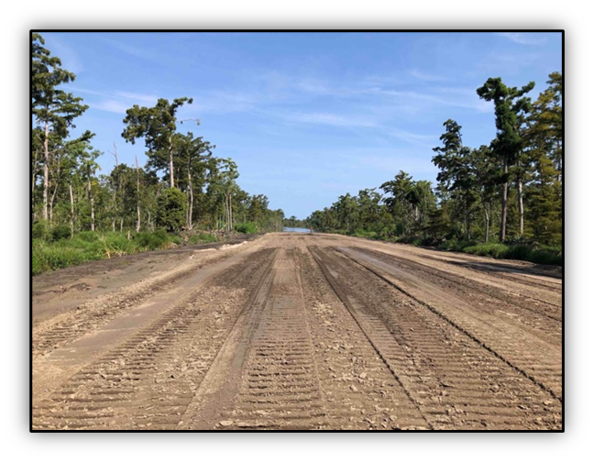
Sand Placement on Levee alignment

Slide 6
Construction Status
WSLP-101 Test Section Contract – Completed June 2022
Final Report Pending
Access Road Contract – Completion November 2022
Roads B, D, F, & S underway.
Roads A, C, G, P, & J complete.
Sand Placement 1 and 2
SP1 (Reach 101) awarded 20 Apr 22 to Phylway for $1.2M (base amount) 145 day base duration. Clearing underway and sand placement beginning this week.
SP2 (Reaches 102 and 103) awarded 11 May 22 to Phylway for $3.1M (base amount) 170 day base duration. Clearing underway.
Stockpile Contracts
Clay 1 – 175k/1000k cubic yards
Clay 2 – 500k/500k cubic yards - Completed
Sand – 600k/600k cubic yards - Completed

Slide 7
Progress on Access Roads D, F, & G

Slide 8
Preliminary Levee Construction Schedule
Existing elevation approx. -1 feet
2023: Construct 3 foot sand base and begin levee construction
2024: Levee built to heights around +6 feet
2025: Levee built to heights ranging +6.6 to +12.5 feet
2026: Levee built to full heights
*Gaps will still exist by flood gates, flood walls, drainage structures, and pump stations through 2026
Current Elevation
-1 ft
Hope Canal
Bonnet Carre
Notes:
2022
Pile load test
2 levee contracts (Reach 109 and 110) Q4 CY2022
2023
8 levee/drainage structures contracts Q1 CY2023
1 drainage structure contract Q2 CY 2023
Single contract for both pump stations Q3 CY2023
2024
3 Western Levee Reaches (Constructed by CPRA as WIK) Q2 CY2024
101a- 106 have wick drains and have an estimated 6 month hold period between each successive lift.
107-110 do not have wick drains due to better soil condition and lower design elevations.

Slide 10
Revised Boring Plan for St. James

Slide 12
Questions

