Slide 1
West Shore Lake Pontchartrain
Stakeholder Update
June 30, 2021
Bradley Drouant, PE, PMP
Sr. Project Manager
New Orleans District
U.S. Army Corps of Engineers

Slide 2
Agenda
General Status
Borrow
Right-of-Entry
St. James Parish Update
https://www.mvn.usace.army.mil/About/Projects/West-Shore-Lake-Pontchartrain/

Slide 3
General Status
St James Parish – PM, ED, and Environmental conducted a site visit with Parish President Dufresne on 28 Jun 21.
Levee construction reaches have been optimized to maximize construction access (shown on following page)
  Currently have 13 levee contracts and 1 pump station contract
Design Optimization Efforts
  These efforts include:
    Reviewing geotechnical parameters that impact the cross section of the levee, CPRA and USACE are close to finalizing this information that will be used going forward
    Initial pump alternatives have been run in HEC-RAS, and have been sent to Stantec for quality control reviews
    ADCIRC model runs to confirm levee design heights are expected to be complete mid-July
What isn’t being changed in this effort?
    Level of risk reduction provided from hurricanes remains 100 yr or 1%
Clay Stockpile contract 1 has begun hauling material approximately 10,000 cy have been placed along access road J, Clay stockpile contract 2 continues to stockpile material in the spillway, Sand Stockpile has also hauled 10,000 cy to access road J.
Access Road J Extension to Test Section WSLP-101 - We have awarded the mod to extend this road and work is underway, expected to reach the pipeline corridor end of July.

Slide 4
General Status (cont.)
WSLP-101:
  The formal request for proposal has been sent to the contractor was due May 19, extended following the response to CT requestions . This is not expected to delay initiation of work as access road J extension is still required.
Remaining Access Roads:
  Advertised 4 June 21, expecting to issue an amendment next week that will result in a two week extension with bids now expected 18 Jul 21 pending receipt of Right of Way/Air Liquide LONO.
  Looking to award contract with remaining access roads in early July with Road A, B, C in base contract and S,D,F, & G as options.
Tree/Clearing Pre-Loading contracts
  Depending on the outcome of the optimization efforts, if levee re-designs are required we may move forward with additional contracts to prepare the alignment and perform preparatory work to continue to move the project forward
Pile Load Test
  BCOE review underway, cannot be finalized until ADCIRC runs are complete
Right of Entry
  PLD has appropriated much of the alignment
  CPRA still working on final LONO across the utility corridor from Air Liquide

Slide 5
Levee Borrow Requirements
Currently estimating a need of about 7.0M – 9.0M cubic yards of levee material for construction
Bonnet Carre’ Spillway (BCS)
  BCS currently has 3.5M CY readily available
  Access issues due to high stages on Mississippi River
Will continue to pursue additional Government Furnished borrow
Contractor Furnished Borrow List used for levee construction in New Orleans not authorized to be used for the WSLP project
WSLP approved to use commercially available borrow sources
  Sources Sought issued to identify commercial borrow sources
  Requirements to become a commercial borrow source were included in the Sources Sought solicitation
  Sources Sought closed 5 Nov 2020. Comments provided to all applicants
  5 pits have been pre-qualified for inclusion on the list
  No additional pits expected to be qualified in the near-term

Slide 6
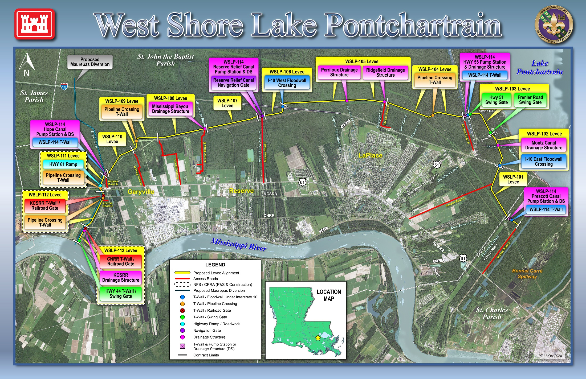

Slide 7
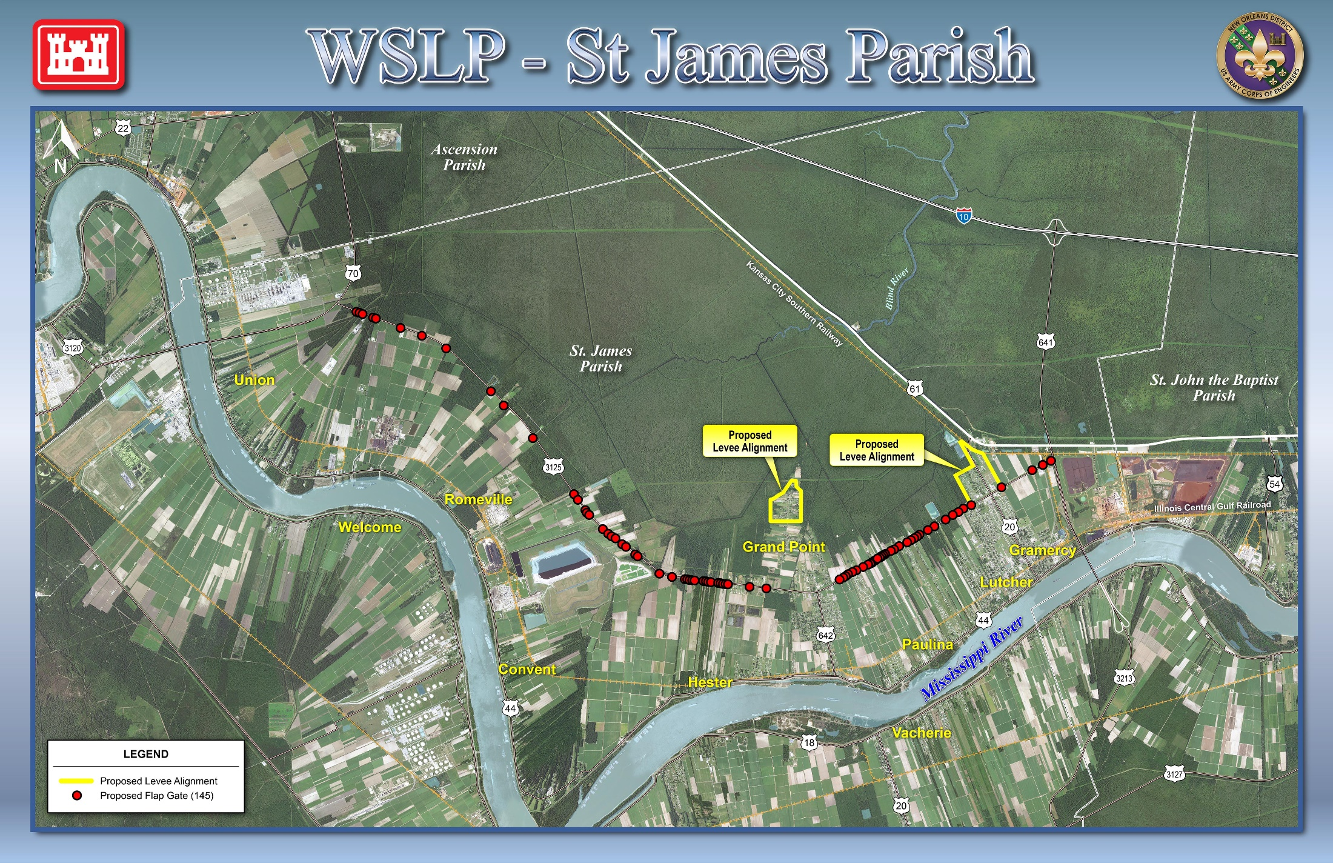

Slide 8
Questions

