Slide 1
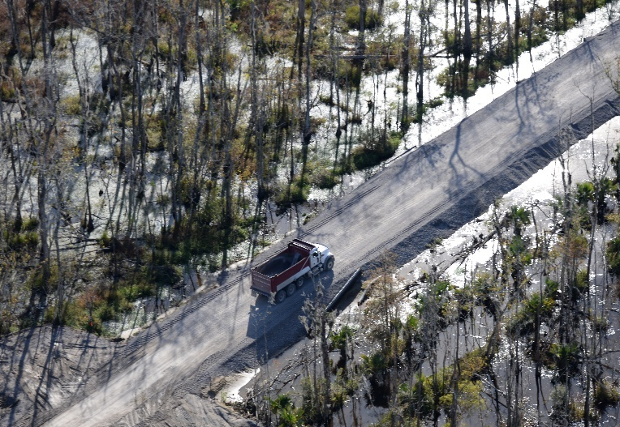
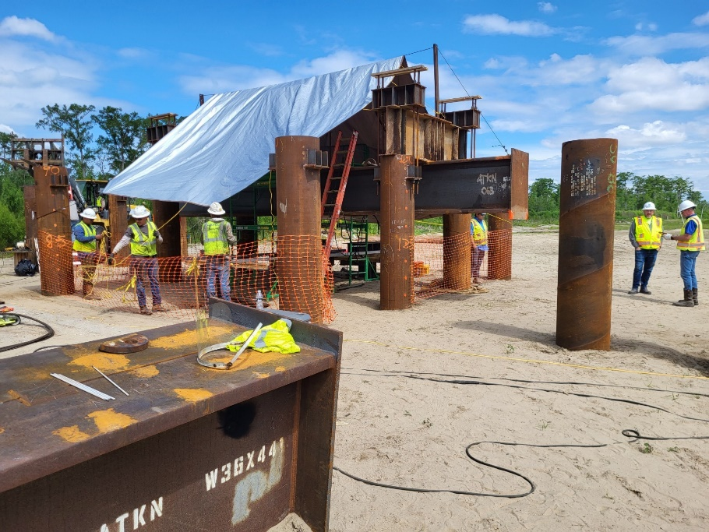
West Shore Lake Pontchartrain Stakeholder Update
November 2023 Bradley Drouant, P.E., PMP Chief – LPV Branch New Orleans District U.S. Army Corps of Engineers

Slide 2
Agenda
Resiliency Study Schedule
Construction Status and Photos/Videos
Design Status
Tentative Delivery Plan
https://www.mvn.usace.army.mil/About/Projects/West-Shore-Lake-Pontchartrain/

Slide 3
Resiliency Study Schedule
DATE​​ | MILESTONE​​
February 27, 2023​​ | Feasibility Cost Share Agreement (FCSA)​​
July 14, 2023 | Alternatives Milestone Meeting (AMM)-120 days​​
March 18, 2025​ | Tentatively Selected Plan (TSP)​​
June 4, 2025 | Release Draft Report and Draft EIS/EA for Concurrent Review​​
October 28, 2025 | Agency Decision Milestone (ADM)​​
October 5, 2027 | Chief's Report​​

Slide 4
Construction Status
WSLP-110 contract was awarded on 21 Dec 22
Clearing and grubbing complete; Sand and clay being placed
WSLP-107 contract was awarded on 15 Mar 23
Clearing and grubbing/burning nearing completion (~90% complete); Excavating bypass channel; Sand and clay being placed
WSLP-101a contract was awarded on 28 April 23
Clearing and grubbing complete; Culvert crossing complete; Excavation of drainage canal; Wick drain installation starting this week; Continuing to haul sand and clay
WSLP-108 contract was awarded on 25 August 23
Contractor mobilized office trailers; Clearing and grubbing underway
WSLP-104 contract was awarded on 25 August 23
Contractor mobilized office trailers; Clearing and grubbing underway

Slide 5
Construction Status
WSLP-106 contract was awarded on 12 September 23
Pre-con meeting was held 11 Oct; Contractor providing initial submittals
WSLP-102 contract was awarded on 14 September 23
Pre-construction meeting was held 24 Oct 23; Contractor providing initial submittals
WSLP-105 contract was awarded on 22 September 23
Pre-construction conference to be held 25 Oct 23; Contractor providing initial submittals
Pile Load Test Contract
Prescott Site: Completed
I-55 Site: Pile driving/Testing complete; actively demobilizing
Reserve Relief Site: Pile driving/Testing complete; actively demobilizing

Slide 6
Construction STATUS
WSLP-110 Construction Progress

Slide 7
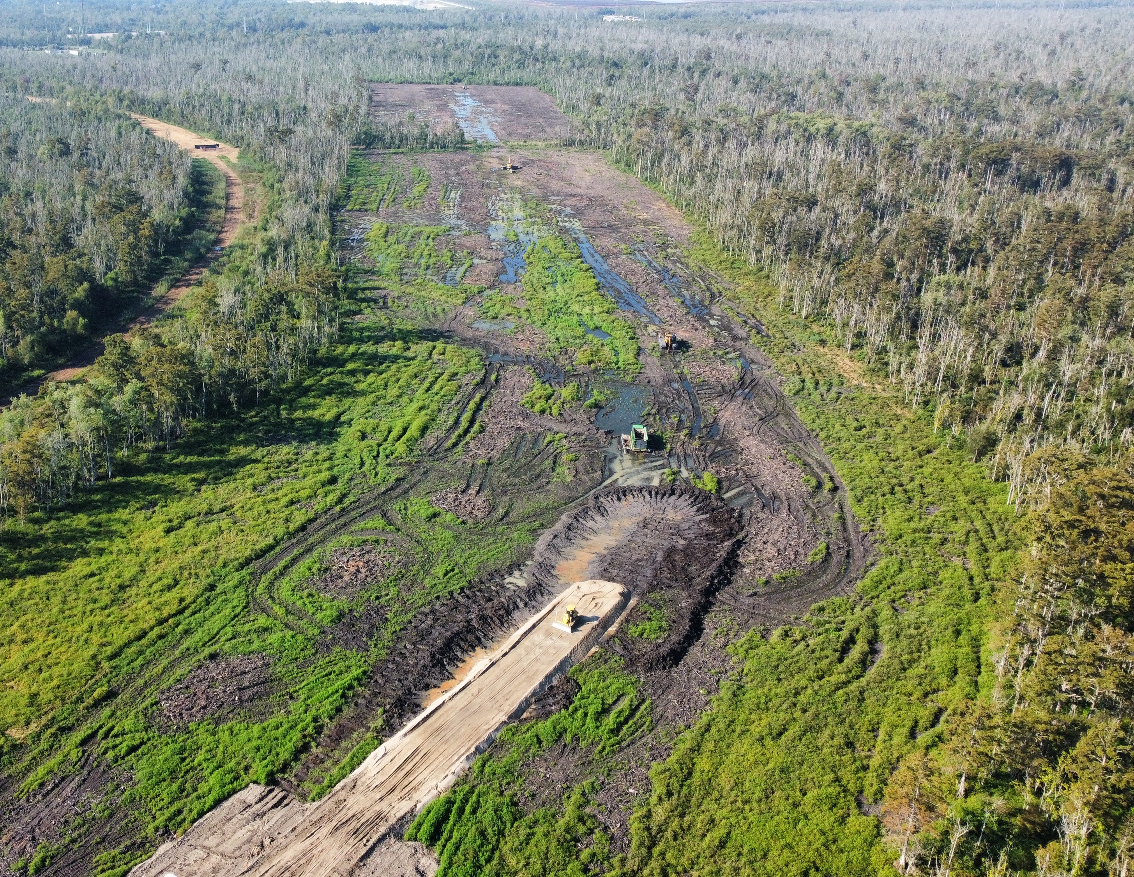
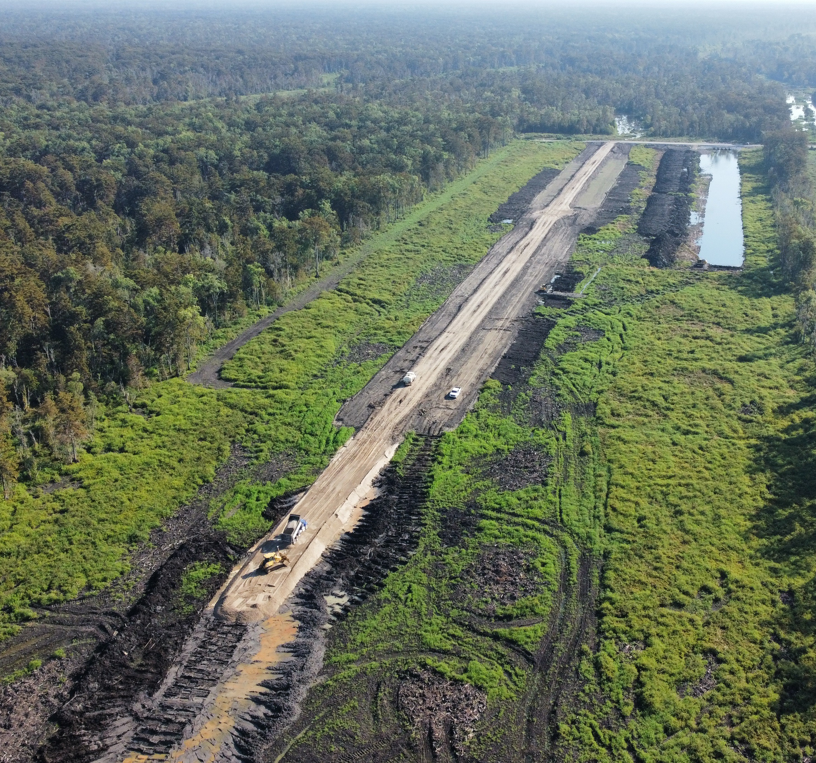
Construction Photos
WSLP-110 Construction Progress

Slide 8
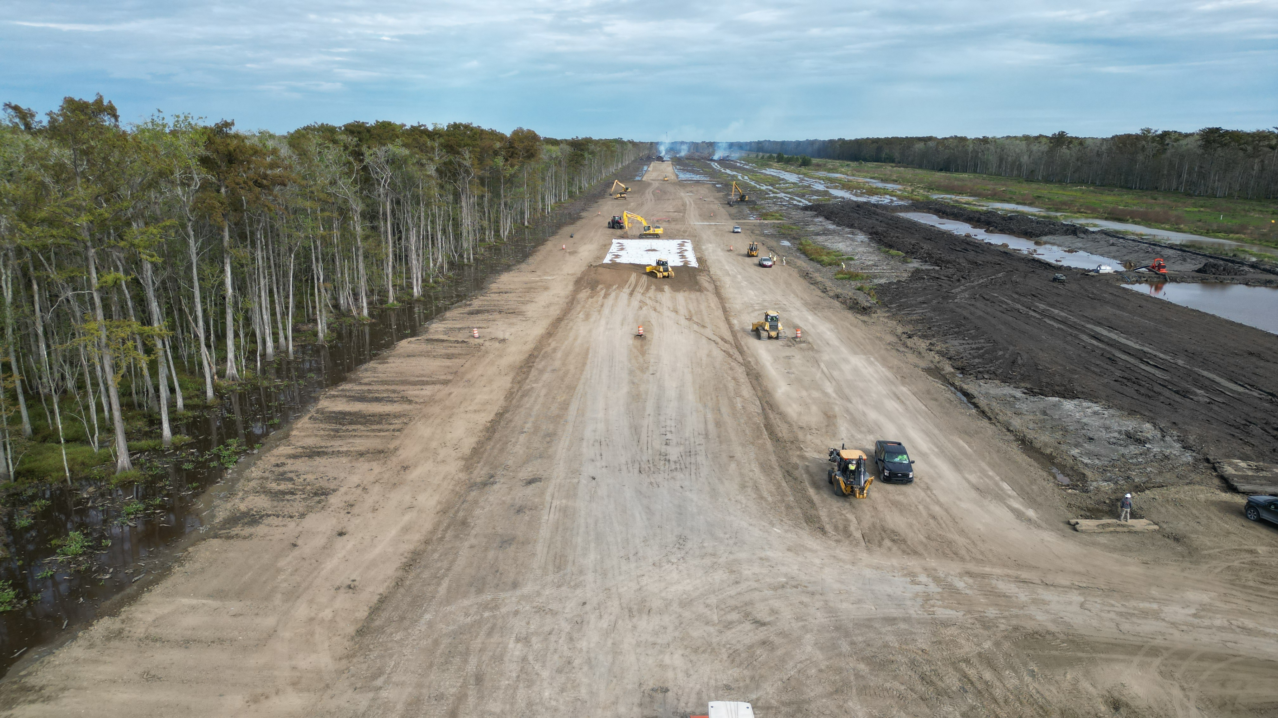
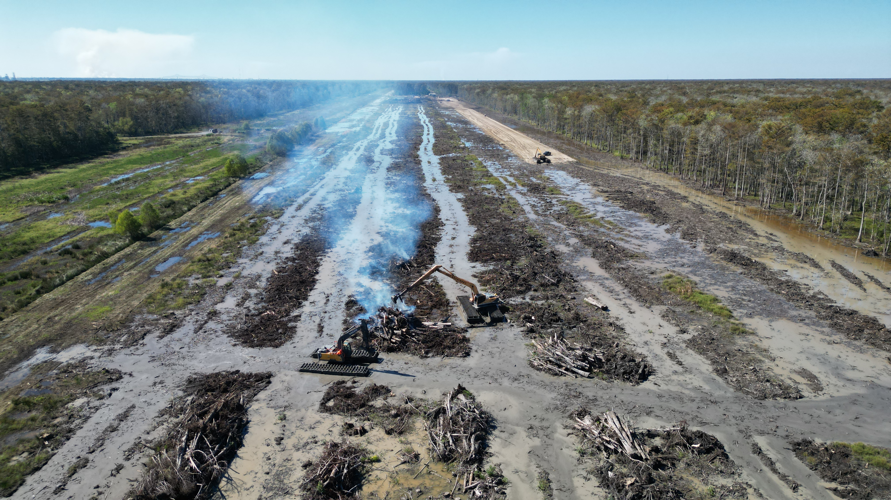
Construction Photos
WSLP-107 Construction

Slide 9
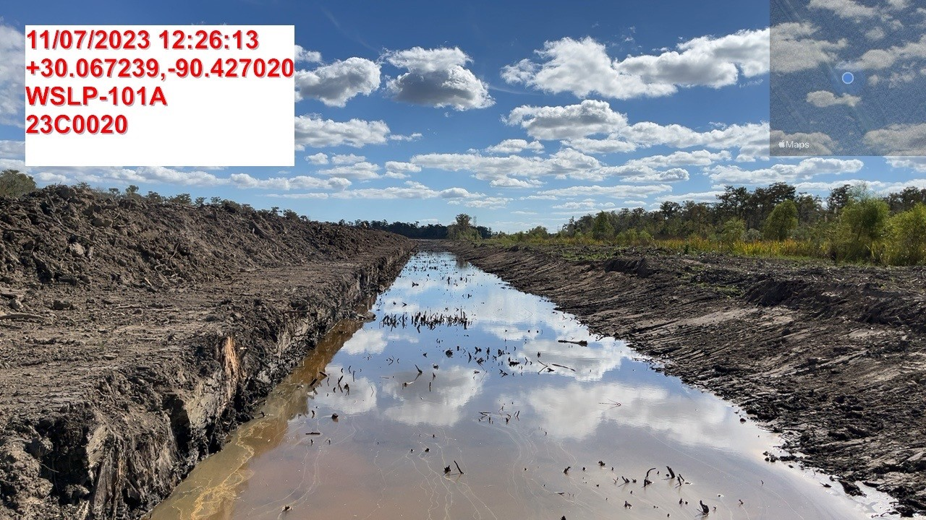
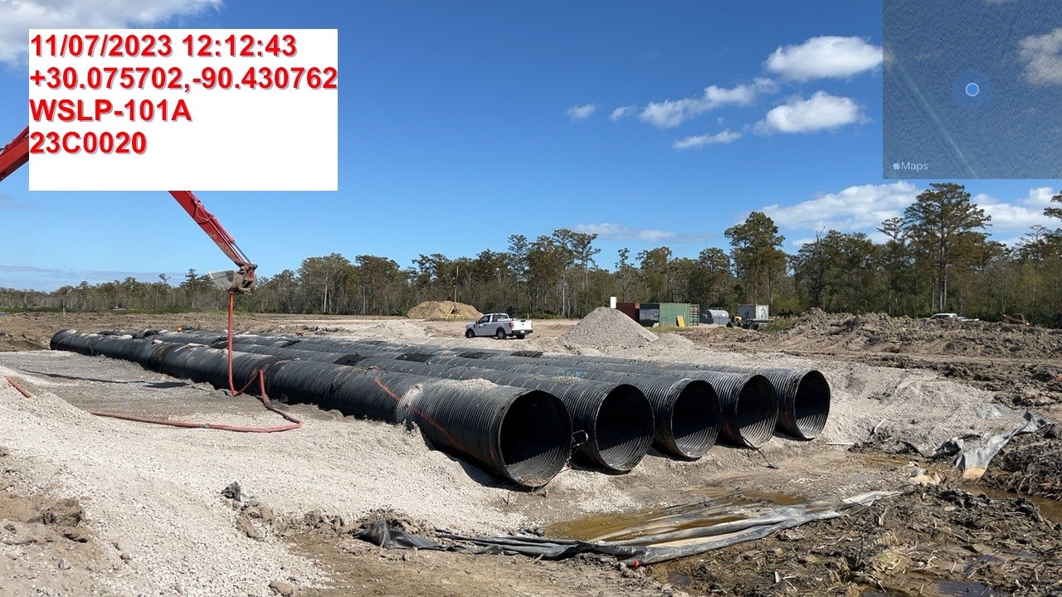
Construction Photos
WSLP-101a Construction

Slide 10
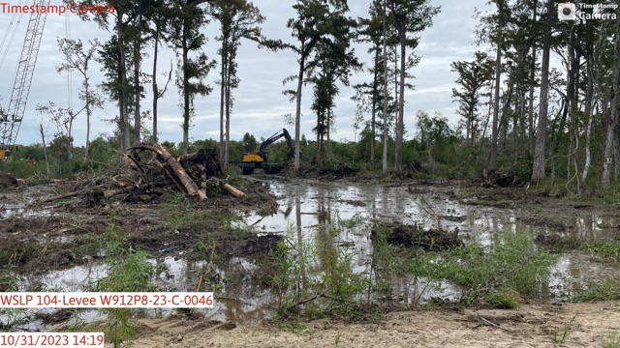
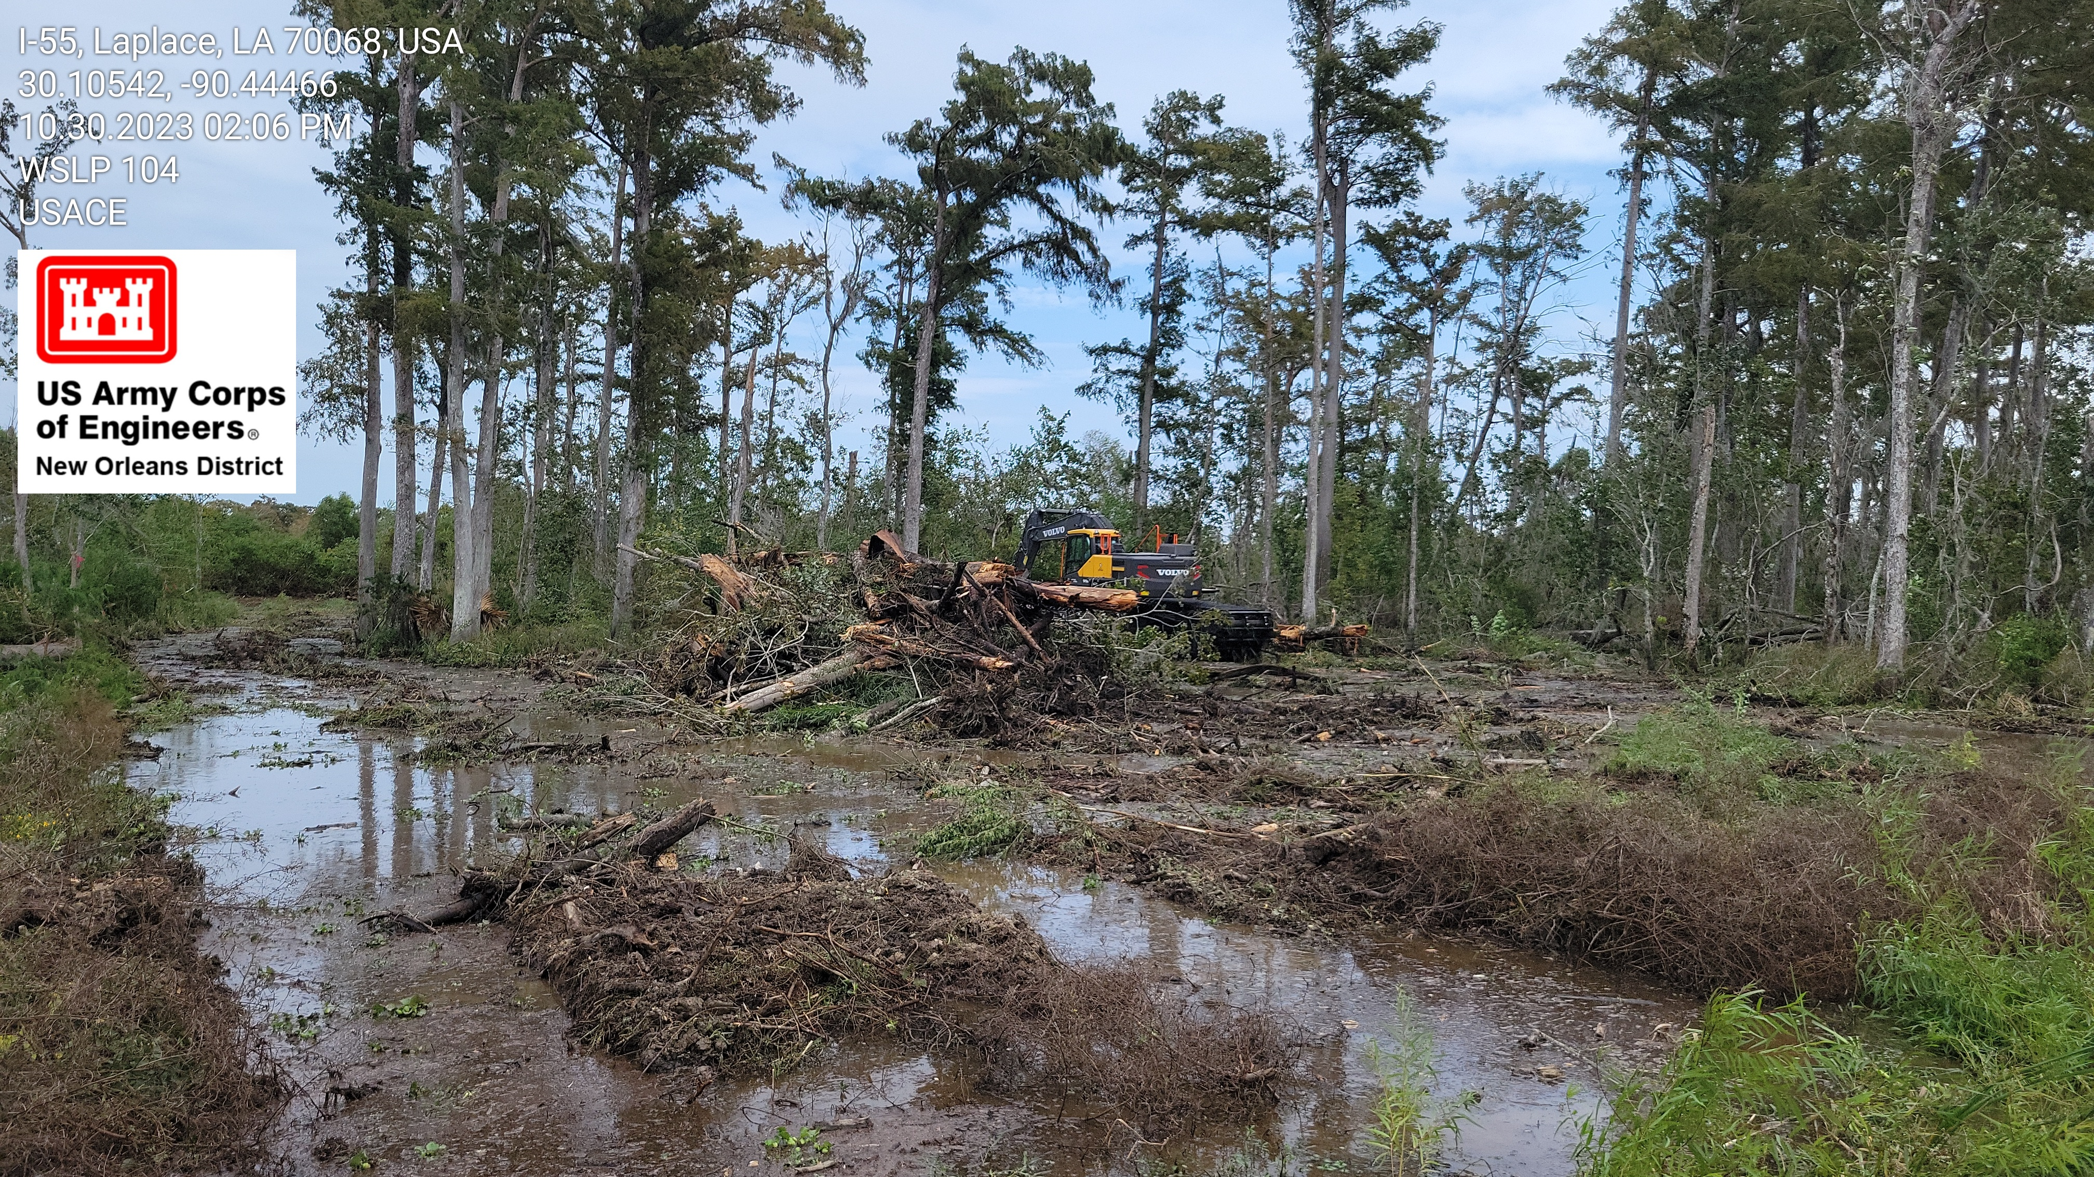
Construction Photos
WSLP-104 Construction

Slide 11
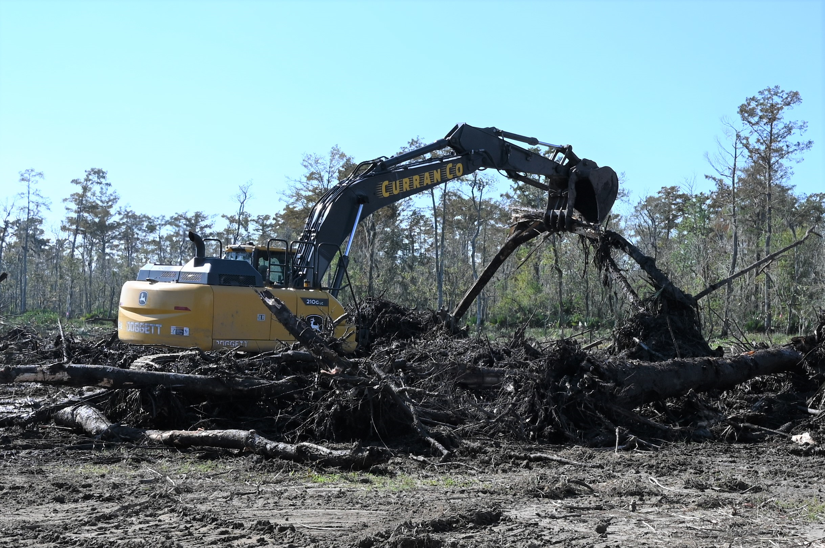
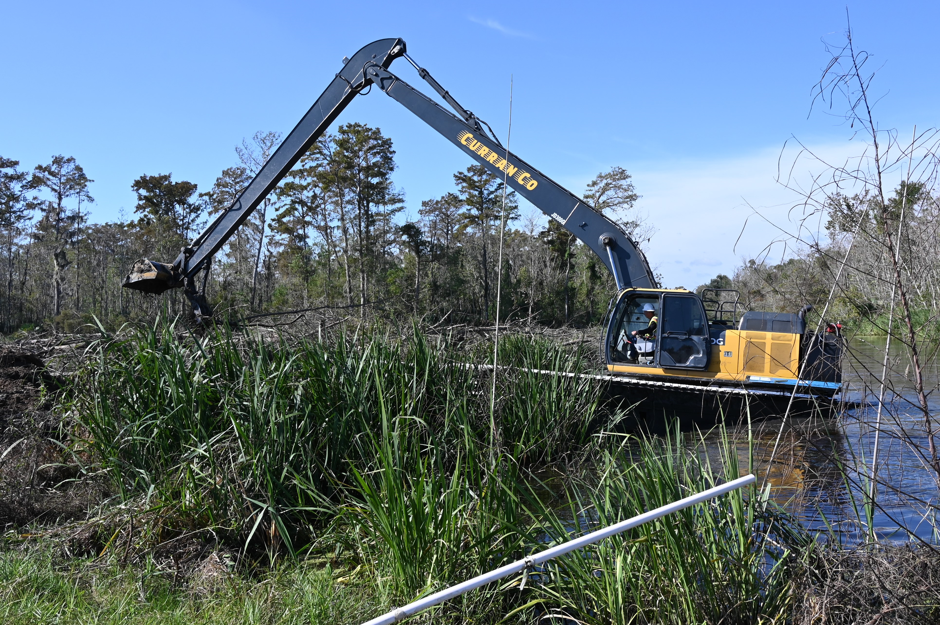
Construction Photos
WSLP-102 Construction

Slide 12
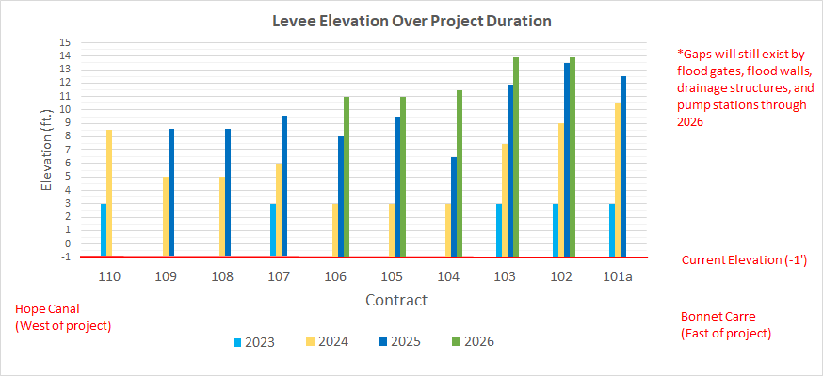
Preliminary Levee Construction Schedule
Existing elevation approx. -1 feet
2023 and 2024: Construct 3-foot sand base and begin levee construction
2024: Levee built to heights around +6 feet
2025: Levee built to heights ranging +6.6 to +12.5 feet
2026: Levee built to full heights

Slide 13
Pre-Award Status Updates
USACE has completed surveys and borings in St. James Parish and is conducting geotechnical analysis/design.
Design to undergo 10% Internal DQC Review.
Public Update Meeting being rescheduled.
Cost Control Board Meeting held on 6 November 23.

Slide 14
West Shore Lake Pontchartrain Tentative Delivery Plan
Contract ID | Description | Award
WSLP 103 | Levee (approx. 1.0 mi.), Floodwall (approx. 500 ft) | 1Q 2024
WSLP 109 | Levee (approx. 1.0 mi), (approx. 500 ft), Utility Crossings | 1Q 2024
WSLP 111** | Levee (approx. 0.5 mi), Highway Ramp, Utility Crossings
WSLP 112** | Levee (approx. 1.0 mi), Rail Road Gate, Floodwall (approx. 500 ft), Utility Crossings
WSLP 113** | Levee (approx. 0.5 mi), Floodwall (approx. 500 ft), Rail Road Gate
WSLP 114 | Pump Stations (2 – 2,000 cfs) | 2Q 2024
WSLP 114a | Hope and Prescott Drainage Structures | 1Q 2024
Note: Project requirements and completion dates may be subject to change as designs are refined and impacts quantified.
**Designed and constructed by CPRA

Slide 17
Questions

