Slide 1
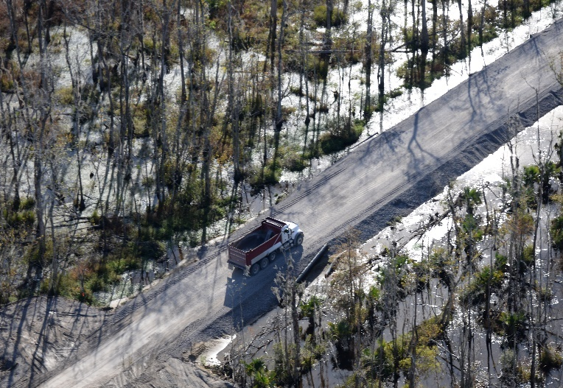
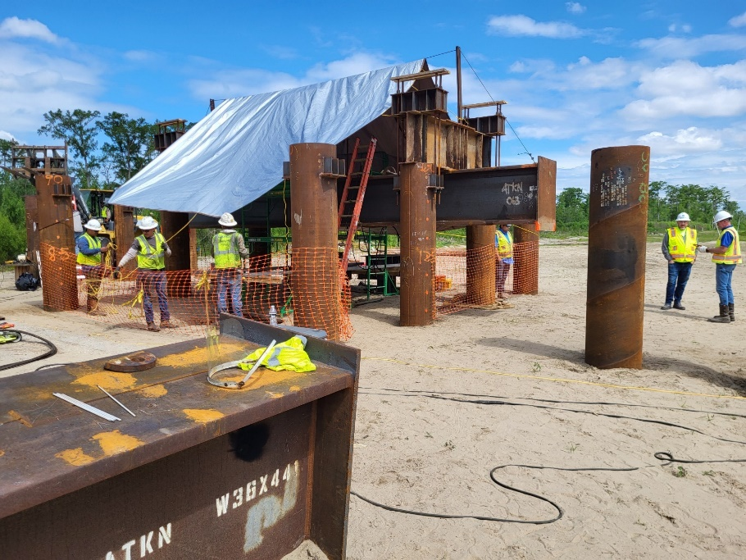
West Shore Lake Pontchartrain
Stakeholder Update
September 2023
Patrick Baudoin, P.G.
Project Manager
New Orleans District
U.S. Army Corps of Engineers

Slide 2
Agenda
Resiliency Study Schedule
Construction Status and Photos/Videos
Design Status
Tentative Delivery Plan
https://www.mvn.usace.army.mil/About/Projects/West-Shore-Lake-Pontchartrain/

Slide 3
Resiliency Study Schedule
DATE​​ | MILESTONE​​
February 27, 2023​​ | Feasibility Cost Share Agreement (FCSA)​​
July 14, 2023 | Alternatives Milestone Meeting (AMM)-120 days​​
March 18, 2025​ | Tentatively Selected Plan (TSP)​​
June 4, 2025 | Release Draft Report and Draft EIS/EA for Concurrent Review​​
October 28, 2025 | Agency Decision Milestone (ADM)​​
October 5, 2027 | Chief's Report​​

Slide 4
Construction Status
WSLP-110 contract was awarded on 21 Dec 22
  Clearing and grubbing/burning still underway; Access road completed; Sand and clay being placed
WSLP-107 contract was awarded on 15 Mar 23
  Clearing and grubbing/burning underway; Culvert crossings completed; bypass channel being excavated; Sand and clay being placed
WSLP-101a contract was awarded on 28 April 23
  Clearing and grubbing underway; Culvert crossing to begin in early October
WSLP-108 contract was awarded on 25 August 23
  Preconstruction meeting held 13 September 23
WSLP-104 contract was awarded on 25 August 23
  Preconstruction meeting scheduled for 28 September 23
WSLP-106 contract was awarded on 12 September 23
WSLP-102 contract was awarded on 14 September 23
WSLP-105 contract was awarded on 22 September 23

Slide 5
Construction Status
Stockpile Contract
  Clay 1 – 475k/1000k cubic yards
Pile Load Test Contract
  Prescott Site: All test piles have been driven
  I-55 Site: Pile driving/Testing complete; actively demobilizing
  Reserve Relief Site: Pile driving complete; testing near completion

Slide 6
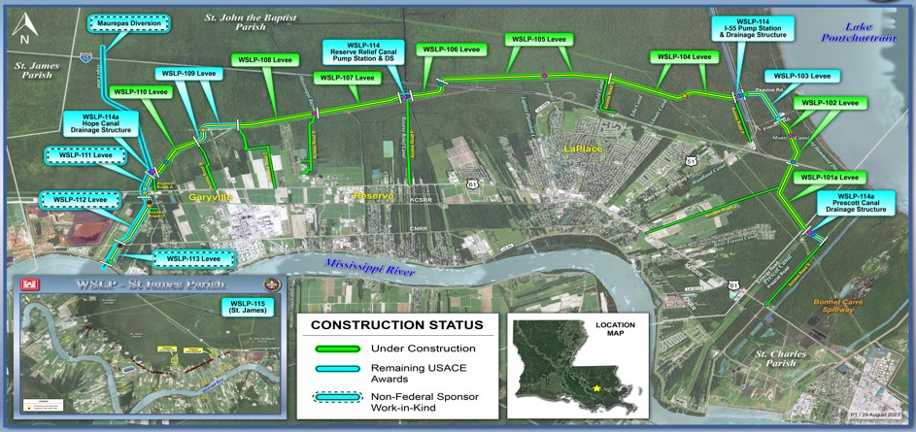
Construction STATUS
WSLP-110 Construction Progress

Slide 7
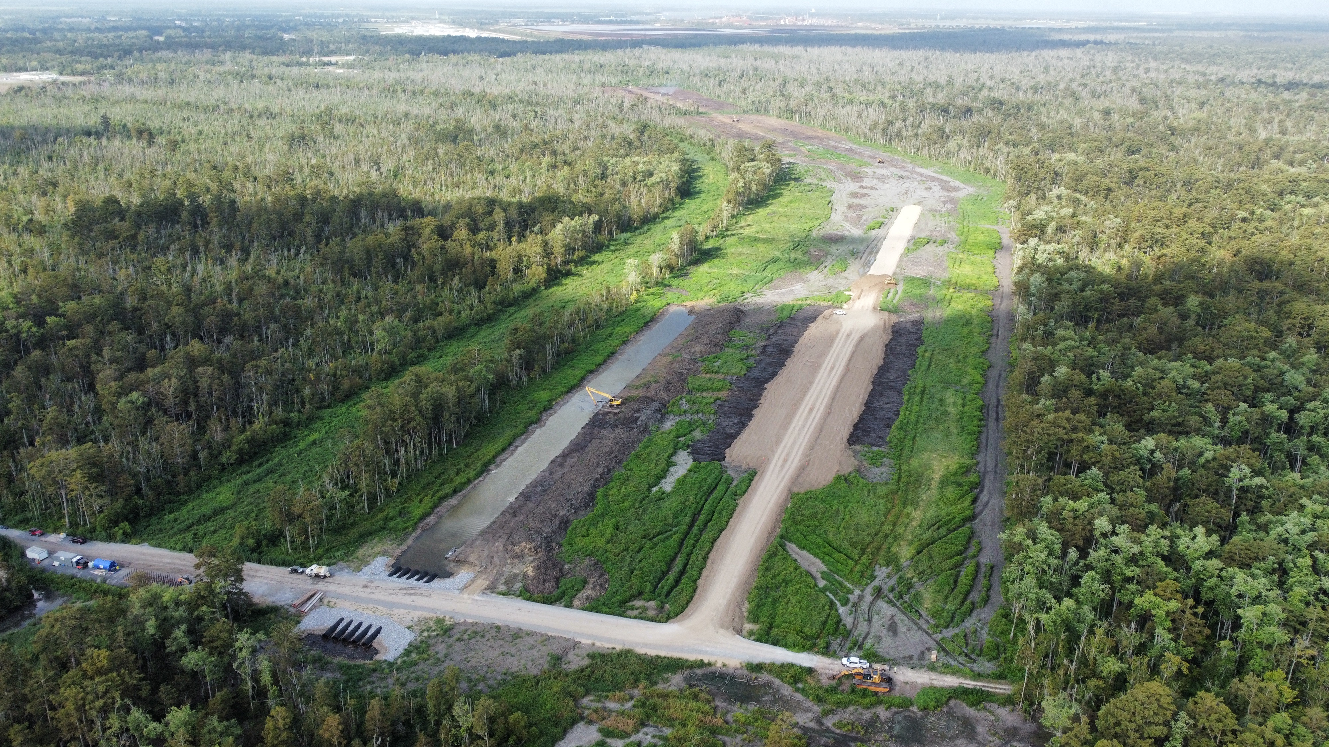
Construction Photos
WSLP-110 Construction Progress

Slide 8
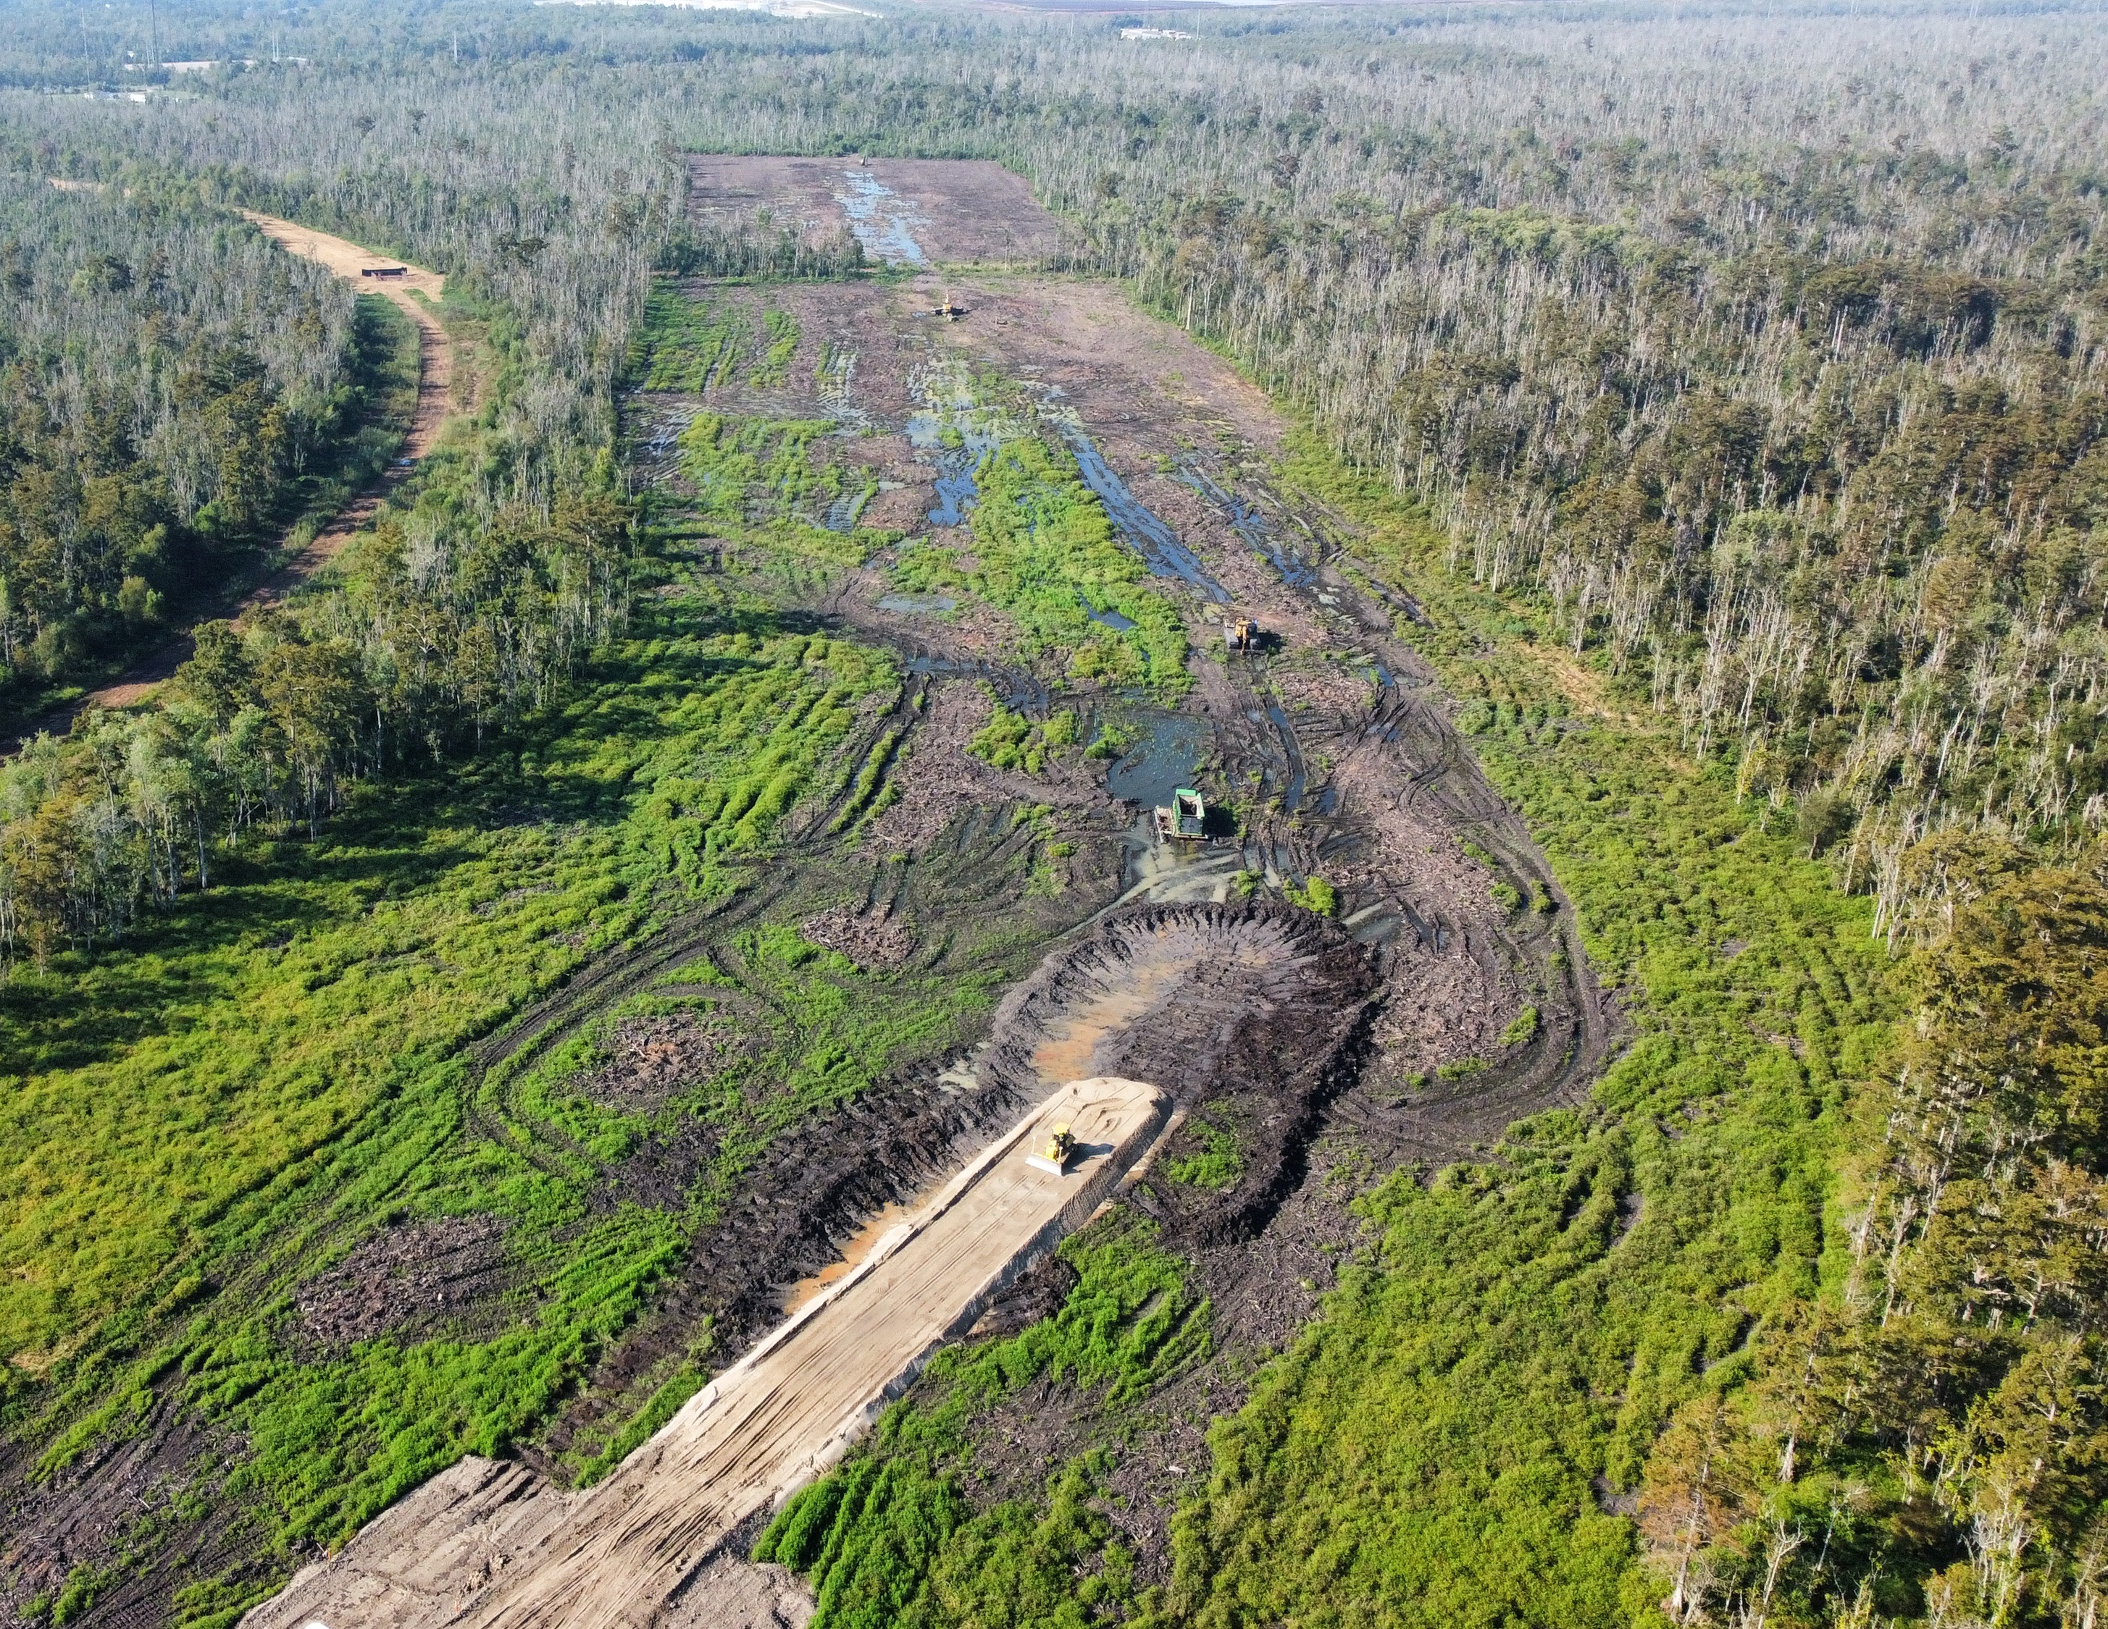
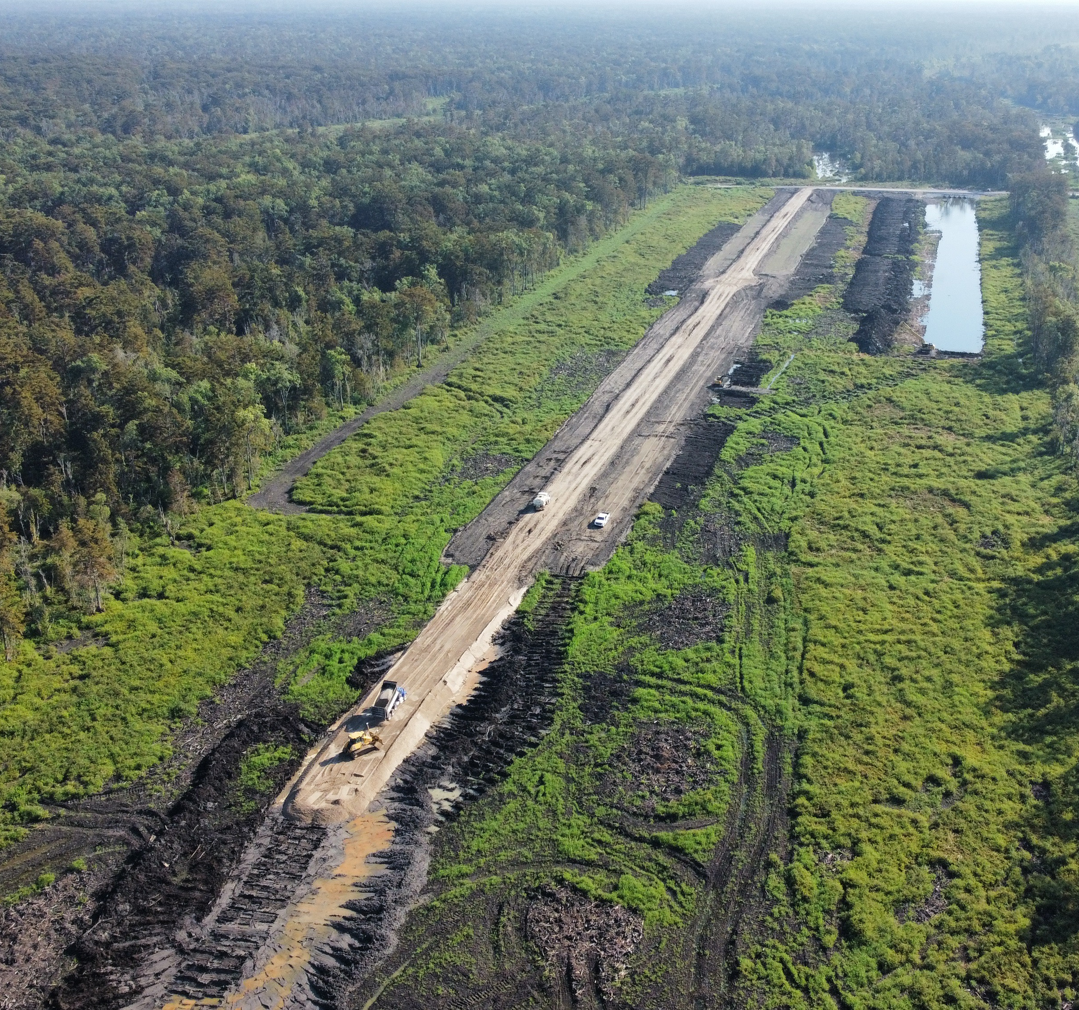
Construction Photos
WSLP-110 Construction Progress

Slide 9
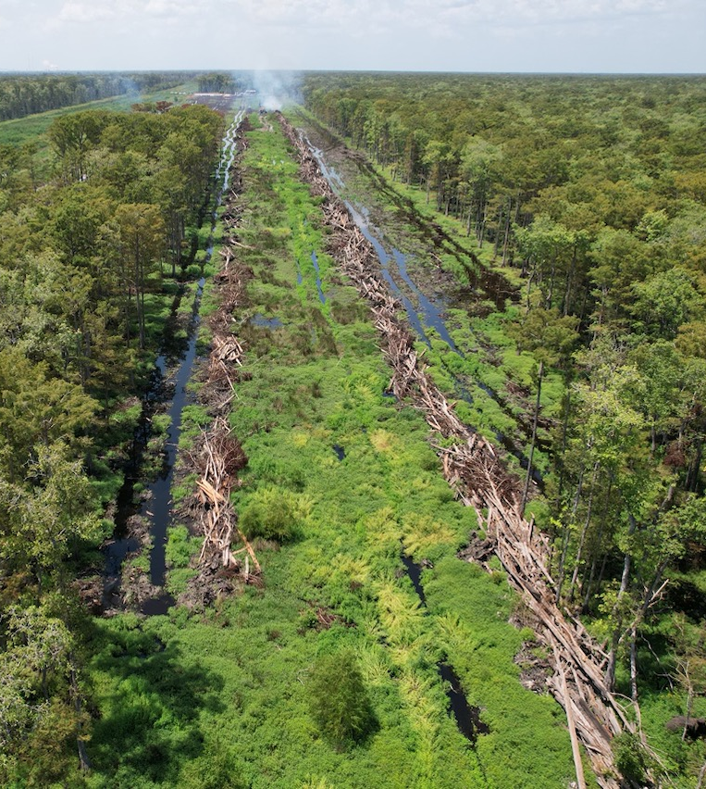
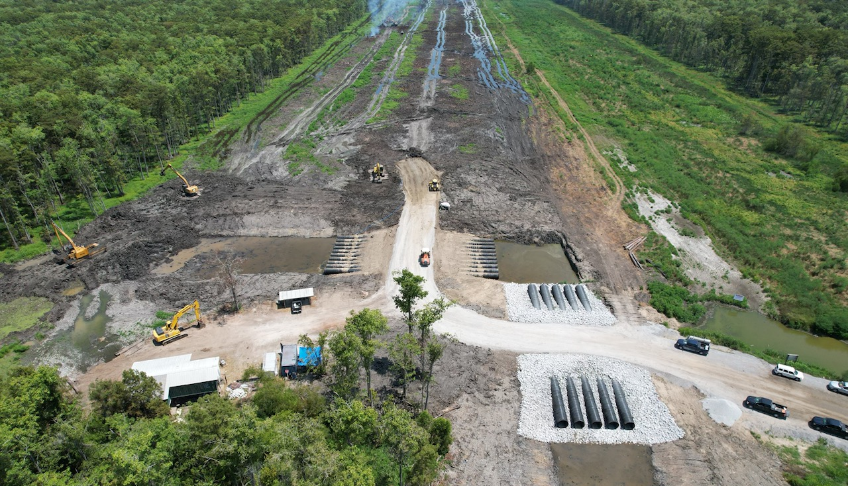
Construction Photos
WSLP-107 Construction

Slide 10
Construction Video
Final WSLP Summer 2023 Update – YouTube
https://www.youtube.com/watch?v=9SXEY7grPJE

Slide 11
Preliminary Levee Construction Schedule
Existing elevation approx. -1 feet
2023 and 2024: Construct 3-foot sand base and begin levee construction
2024: Levee built to heights around +6 feet
2025: Levee built to heights ranging +6.6 to +12.5 feet
2026: Levee built to full heights

Slide 12
Pre-Award Status Updates
USACE has completed surveys and borings in St. James Parish and is conducting geotechnical analysis/design.
    Design to undergo 10% Internal DQC Review.
Public Update Meeting being rescheduled.

Slide 13
West Shore Lake Pontchartrain Tentative Delivery Plan
Contract ID | Description | Award
WSLP 103 | Levee (approx. 1.0 mi.), Floodwall (approx. 500 ft) | 1Q 2024
WSLP 109 | Levee (approx. 1.0 mi), (approx. 500 ft), Utility Crossings | 1Q 2024
WSLP 111** | Levee (approx. 0.5 mi), Highway Ramp, Utility Crossings
WSLP 112** | Levee (approx. 1.0 mi), Rail Road Gate, Floodwall (approx. 500 ft), Utility Crossings
WSLP 113** | Levee (approx. 0.5 mi), Floodwall (approx. 500 ft), Rail Road Gate
WSLP 114 | Pump Stations (2 – 2,000 cfs) | 2Q 2024
WSLP 114a | Hope and Prescott Drainage Structures | 1Q 2024
Note: Project requirements and completion dates may be subject to change as designs are refined and impacts quantified.
**Designed and constructed by CPRA

Slide 14
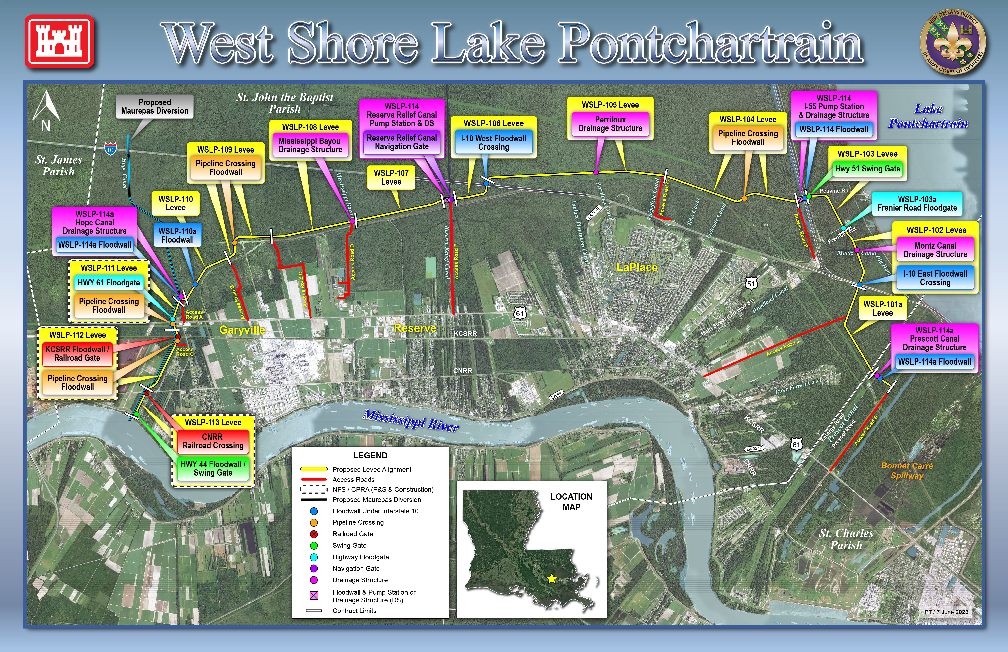

Slide 15
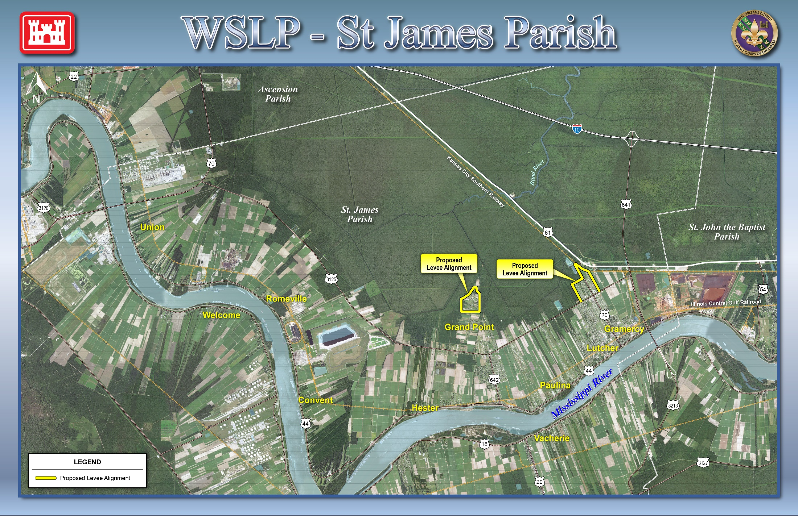

Slide 16
Questions

